Slide 1
Understanding the Cause and Effect of Digital Distress in Illinois
Master’s Thesis
Saiprasanna Cheedepudi (856496421)

Slide 2
Introduction
Digital Distress
Device Deficient - Lack of any Internet-access capable computing device, or having only one such device
Internet Insufficiency - Either the lack of Internet subscription, or access through only low data-rate dial-up connectivity, or having only a cellular data subscription plan.
Machine Learning Classification Models
Correlation
Cross validation
Tuning Hyperparameters

Slide 3
Digital Distress
Digital distress is defined here as census tracts (neighborhoods) that had a 1) high percent of homes not subscribing to the internet or subscribing only through a cellular data plan and a 2) high percent of homes with no computing devices or relying only on mobile devices.
Digital inclusion is explored through looking at two broad indicators: type of internet subscription (or lack of) and device ownership (or lack of).
Four indicators are considered:
percent of homes with a cellular data only subscription
percent of homes with no internet access (not subscribing)
percent of homes relying only on mobile devices
percent of homes not owning a computing device

Slide 4


Slide 5
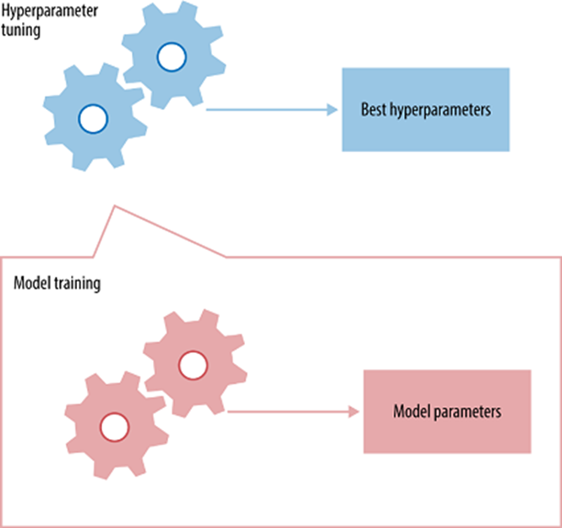

Slide 6
Background Story
Group all IL households into 4 categories (4.866M households)
Connected, with Device (CD) 72%
Device Deficient (DD) 4%
Internet Insufficient (II) 10%
Fully Disconnected (FD) 14%

Slide 7
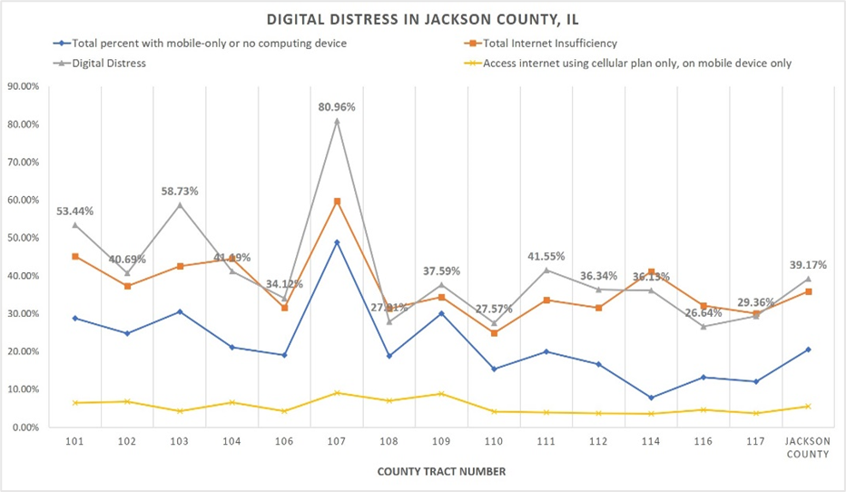

Slide 8
Data preparation
Collected data from U.S. Census Bureau American Community Survey (ACS)
Combined data from 4 tables to a single table.
Each row represents data of unique ZIP code from Illinois.
Have a total data of 1384 in the data set.
Do have 20 features and target column is digital distress.
Data is continuous.
Convert Digital distress column to categorial, speaking low, low moderate,moderate and high.

Slide 9
Convert to categorial data
Categorial values used for the digital distress are Low, Low moderate, Moderate and High.
These values are defined as
Low - =IF (value<7.36)
Low moderate - =IF (value(A2>=7.36 AND A2<22.09))
Moderate - =IF((A2>=22.09 AND A2<86.2975))
High - =IF((A4>=86.2975 AND A4<1826.75))

Slide 10
Digital Distress Values
Row Labels Count of Digital distress
Moderate 346
Lowmoderate 346
High 346
Low 346
Grand Total 1834
1384

Slide 11
Features in data set
Device Deficient
Internet Insufficient
Income:Less than $20,000
Income: $20,000 to $74,999
Income: $75,000 or more
Race & Ethnicity:White alone
Race & Ethnicity: Black or African American alone
Race & Ethnicity: American Indian and Alaska Native alone
Race & Ethnicity: Asian alone
Race & Ethnicity: Native Hawaiian and Other Pacific Islander alone
Below poverty level
At or above the poverty level
Education:Less than high school graduate
Education:High school graduate (includes equivalency)
Education: Some college or associate's degree
Education: Bachelor's degree or higher
Age:45 to 54 years
Age: 55 to 59 years
Age: Under 18 years
Age: 18 to 24 years
Age: 15 to 44 years
Age: 60 years and over
Digital distress

Slide 12
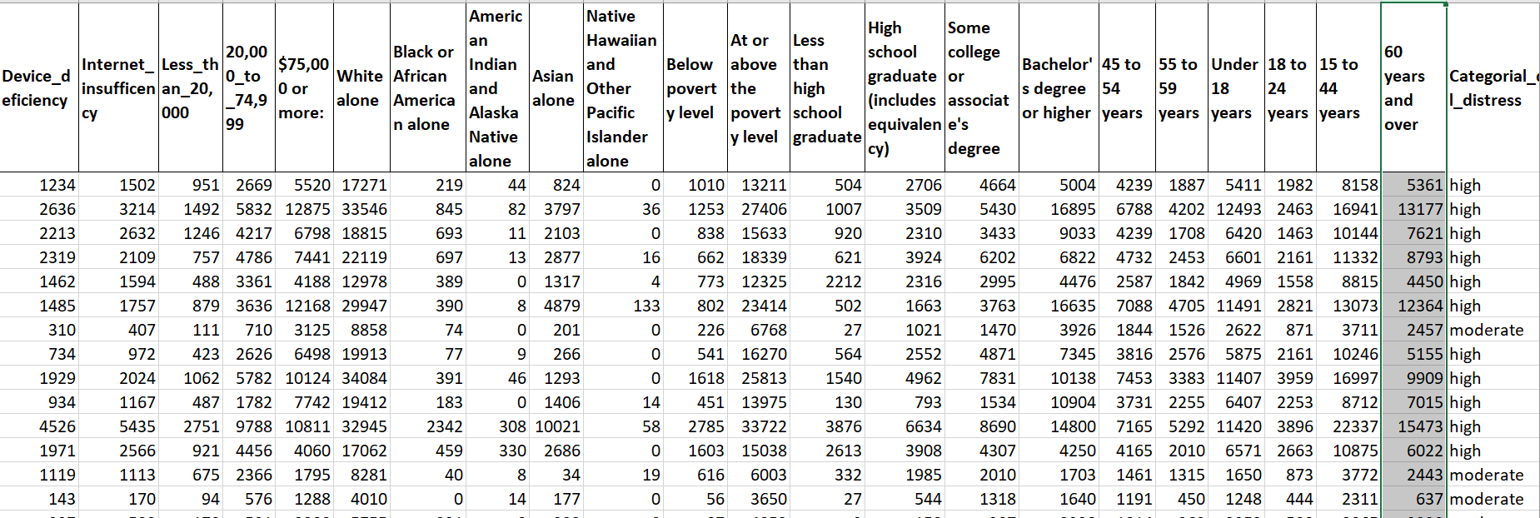

Slide 13
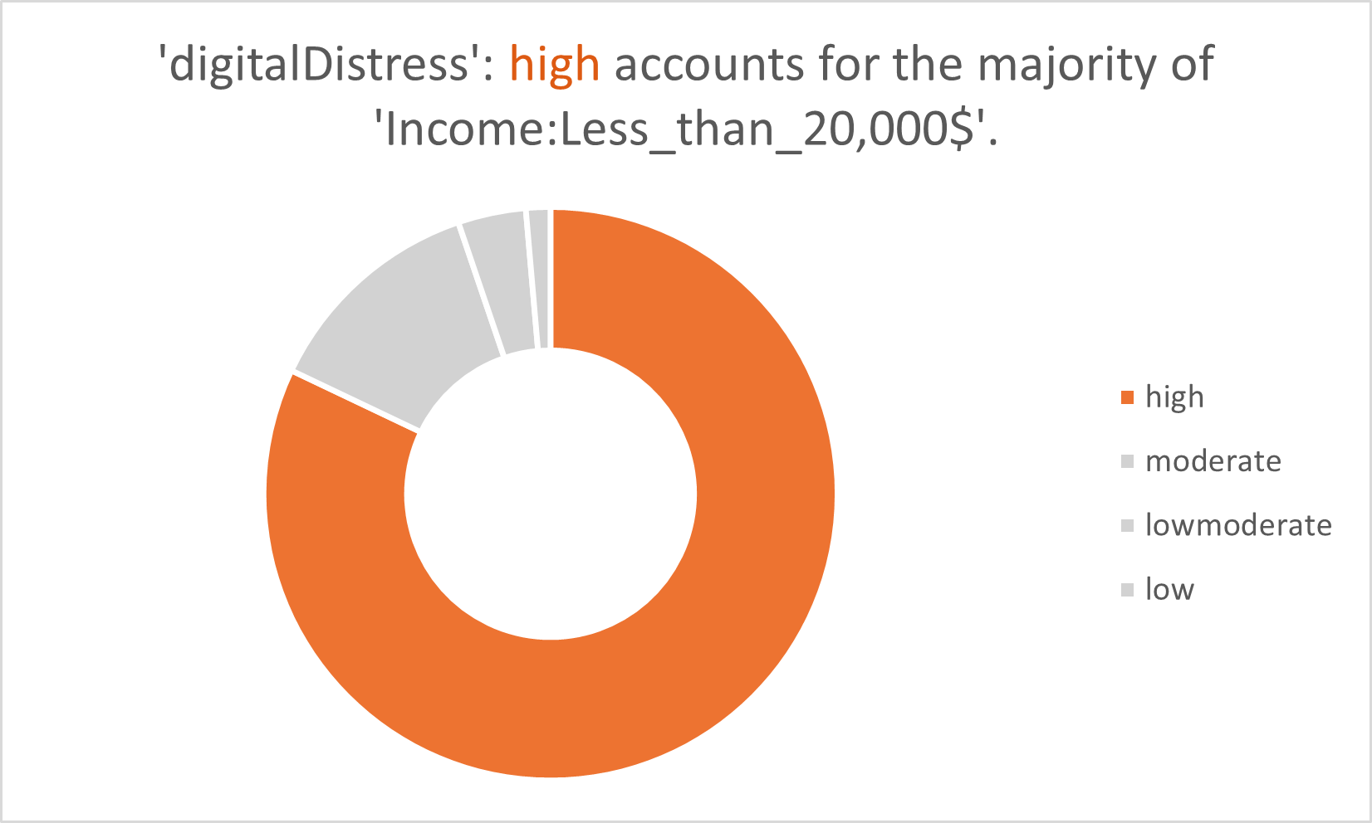

Slide 14
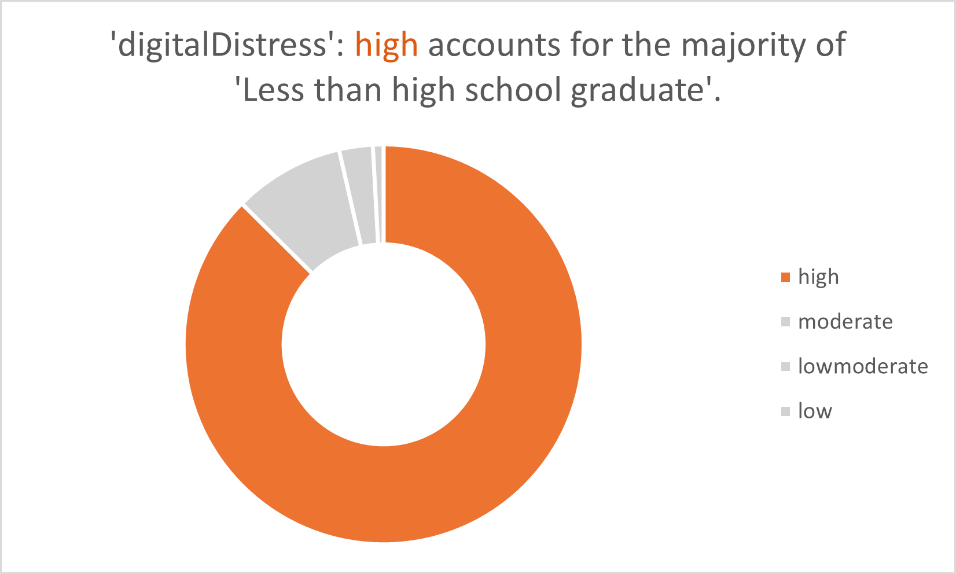

Slide 15
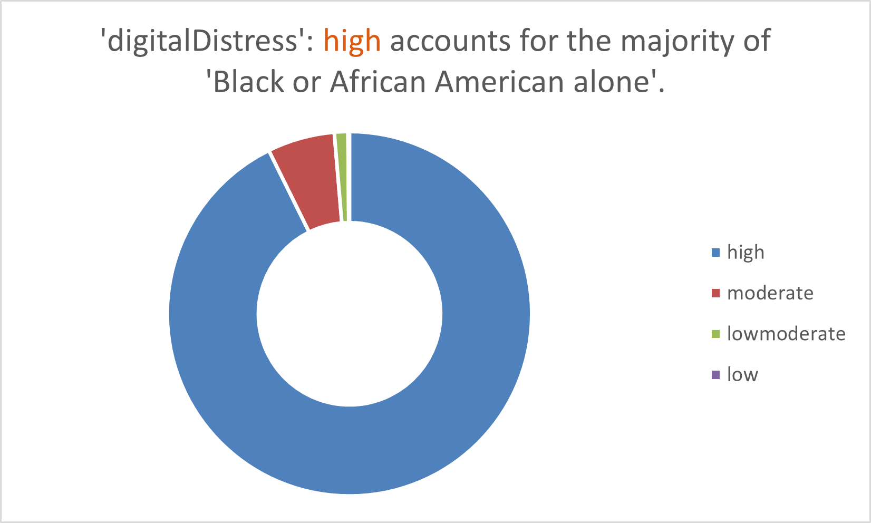

Slide 16
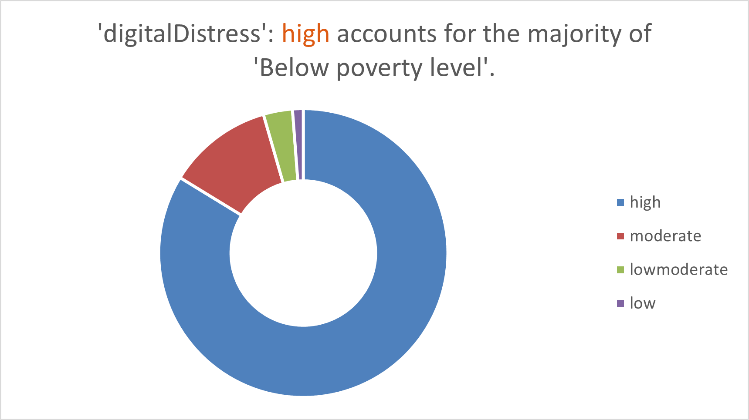

Slide 17
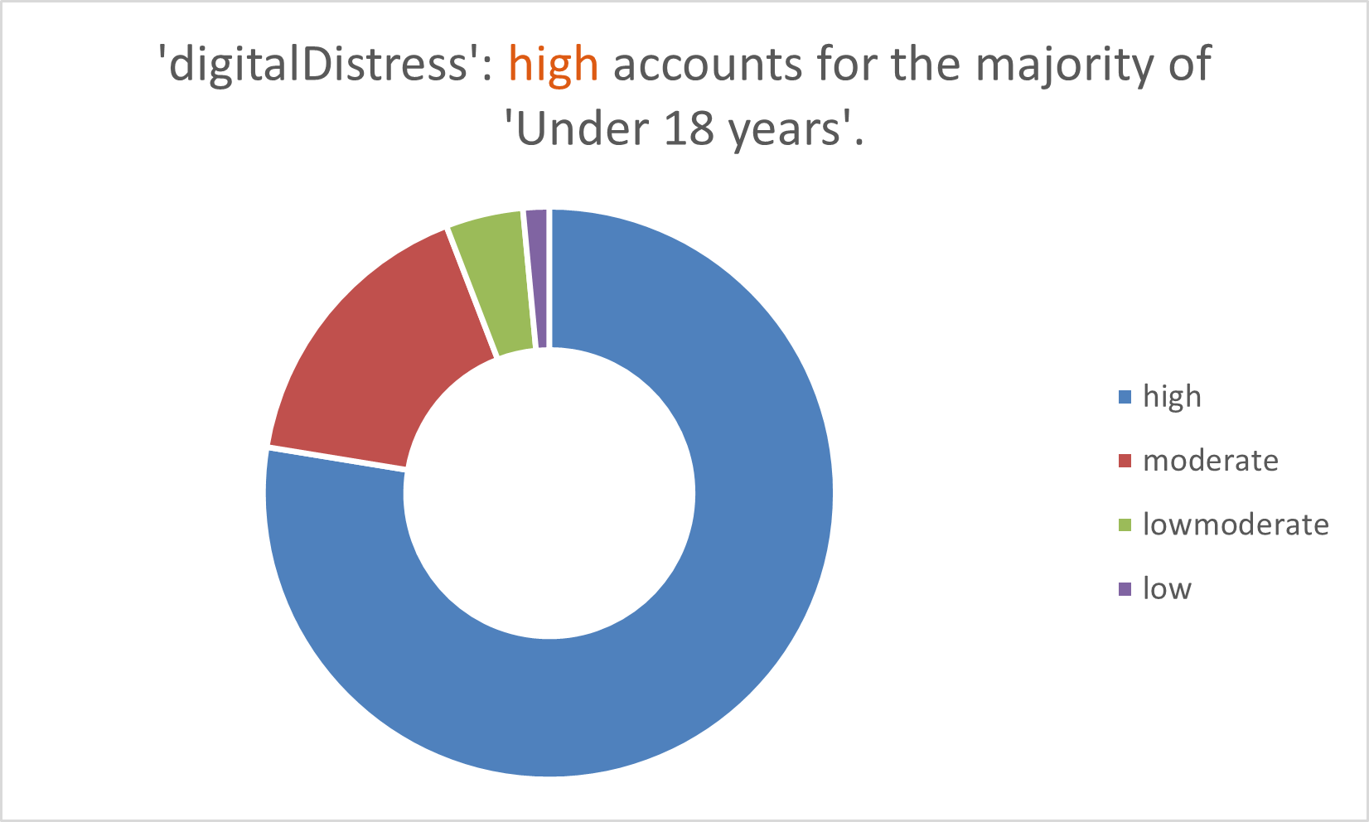

Slide 18
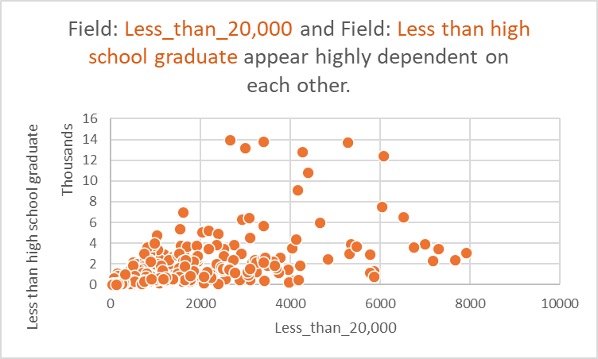

Slide 19
Correlation Results on Digital Distress
Device deficiency 0.941905
Internet insufficency 0.936914
Less than $20,000: 0.879079
$20,000 to $74,999: 0.895473
$75,000 or more: 0.578197
White alone 0.593048
Black or African American alone 0.718632
American Indian and Alaska Native alone 0.635942
Asian alone 0.380462
Native Hawaiian and Other Pacific Islander alone 0.248950
Below poverty level 0.865343
At or above the poverty level 0.766341
Less than high school graduate 0.813912
High school graduate (includes equivalency) 0.885736
Some college or associate's degree 0.850139
Bachelor's degree or higher 0.475764
45 to 54 years 0.783510
55 to 59 years 0.779779
Under 18 years 0.829878
18 to 24 years 0.717530
60 years and over 0.786252

Slide 20
Machine Learning models
Classification models
Decision Tree
Random Forest
SVM
KNN classifier
Logistic
Naive Bayes

Slide 21
Accuracy
Model Accuracy
0 Random Forest 0.735577
1 Decision Tree 0.661058
2 Naive Bayes 0.605769
3 SVC 0.653846
4 KNN 0.706731
5 Logistic 0.569712

Slide 22
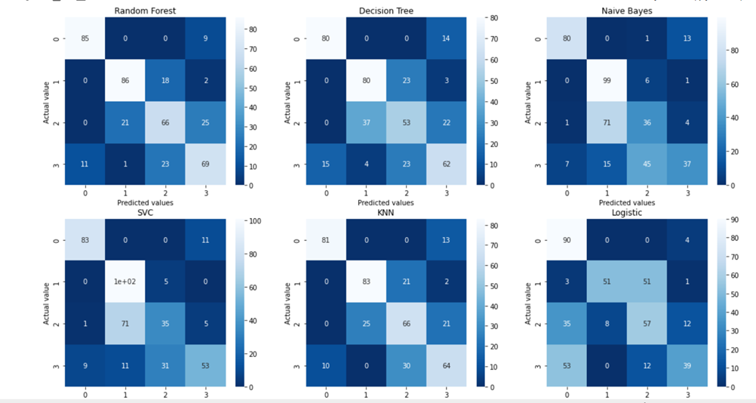

Slide 23
PCA Values
[8.65563110e-01 7.88723635e-02 2.23913578e-02 1.36227129e-02
8.84981152e-03 3.57144713e-03 2.82121181e-03 1.62112909e-03
7.89301490e-04 4.38262437e-04 3.51287264e-04 2.79752143e-04
2.18599558e-04 1.68261505e-04 1.33426269e-04 1.09816805e-04
8.10789926e-05 7.05674452e-05 3.23740941e-05 9.89289132e-06
3.65312362e-06 5.82257503e-07]
Cross Validation:
With GridSearchCV on Decision Tree Classification model,
The accuracy is 0.7331730769230769

Slide 24
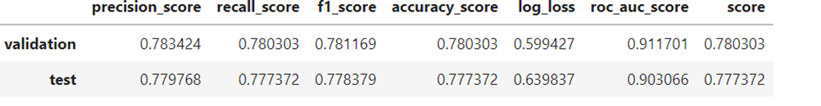
Decision Tree
DecisionTreeClassifier(criterion='entropy',
max_depth=11,
max_features=0.8301024279155249,
min_samples_leaf=0.2277036762124418,
min_samples_split=0.2009520698298776,
random_state=542470820)

Slide 25
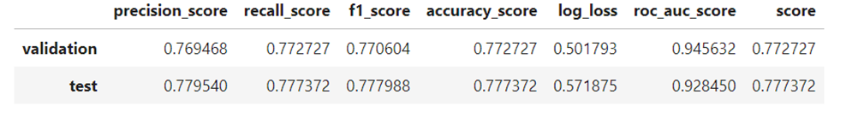
Random Forest
RandomForestClassifier(criterion='entropy',
max_depth=5,
max_features=0.6772485796634158,
min_samples_leaf=0.03707910745988508,
min_samples_split=0.04600774138805236,
n_estimators=177,
random_state=542470820)

Slide 26
Future Work
The data can be collected all over the United States or starting from Mid-west countries and then expanding.
Add any factors to the model or may remove from the model for better training of data.
To achieve the objective of overcoming the problem of Digital Distress in Illinois:
Ø Need to educate the people to stay CONNECTED.
Ø Conduct a workshop to train local businesses on the use of digital technologies for their operations and gather their feedback.

Slide 27
Thank you

